Slide 1

Hacking Environment Web Application
Detailed Developer Report

Slide 2
Security Status – Extremely Vulnerable
Hacker can steal all records in Internshal databases (SQLi)
Hacker can take control of complete server including View, Add, Edit, Delete files and folders (Shell Upload)
Hacker can change source code of application to host malware, phishing pages or even explicit content (Shell Upload)
Hacker can inject client side code into applications and trick users by changing how page looks to steal information or spoil the name of Internshala (XSS)
Hacker can extract order History of all customers using Userid (IDOR)

Slide 3
Vulnerability Statistics
Critical
18
Severe
14
Moderate
2
Low
2

Slide 4
Vulnerabilities:
No | Severity | Vulnerability | Count
1 | Critical | SQL Injection | 3
2 | Critical | Default/Weak Password | 2
3 | Critical | Bruteforcing Attack | 2
4 | Severe | Insecure Direct Object Referance | 3
5 | Critical | Cross Site Scipting (XSS) | 2
6 | Critical | Forced Browsing | 2
7 | Severe | Default Files And Pages | 4
8 | Low | Rate Limiting Flaw | 1
9 | Severe | PII Leakage | 3
10 | Low | Open Redirection | 1
11 | Severe | Command Execution Vunerability | 2
12 | Severe | File Inclusion Vunerability | 1
13 | Critical | Insecure File Upload Vunerability | 4
14 | Severe | Client Side Filters | 1
15 | Moderate | Server Misconfiguration | 2
16 | Critical | Cross Site Request Forgery | 2
17 | Critical | Component With Known Vunerability | 1

Slide 5
1. SQL Injection
SQL Injection (Critical) | Below mentioned URL in the Lifestyle Store is vulnerable to SQL injection attack Affected URL : http://13.232.110.86/search/search.php?q=HERE Affected Parameters : q (GET parameter) Payload: q=socks’

Slide 6
1. SQL Injection
SQL Injection (Critical) | Here are other similar SQLi in the application Affected URL : http://13.232.110.86/products.php?cat=HERE (cat GET parameter) http://13.232.110.86/products.php (page POST parameter)

Slide 7
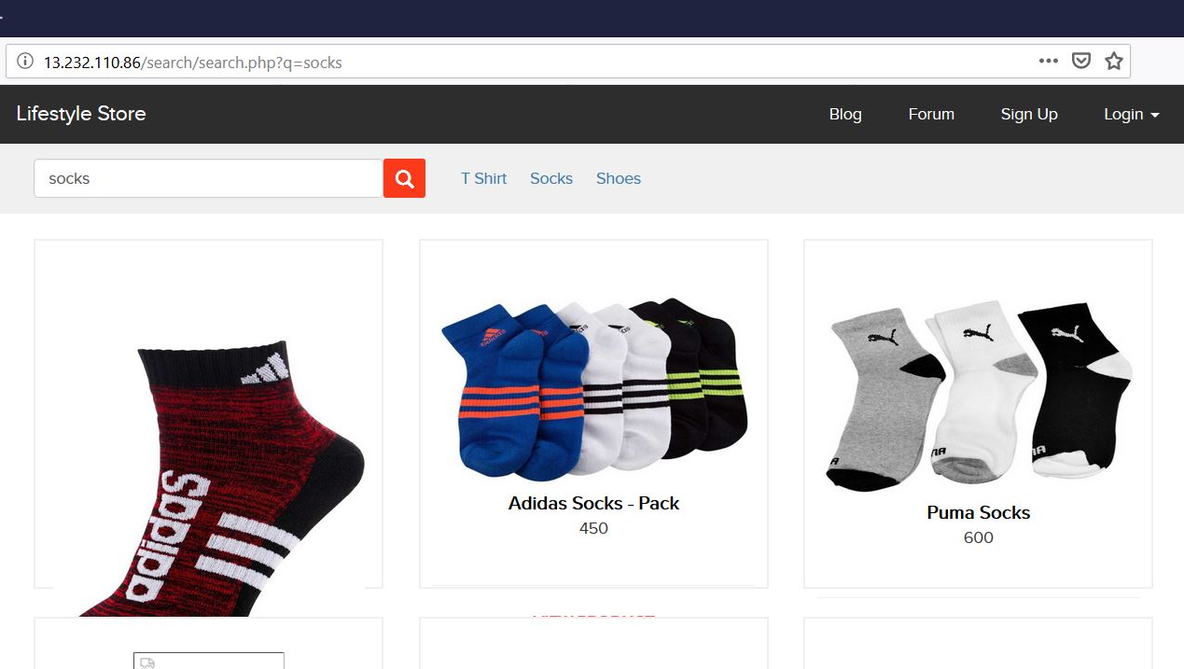
Observation
Navigate to Products page where you will see list of products . Search any one category like socks. You will see all the socks available in store. Notice the GET parameter q in the URL:

Slide 8
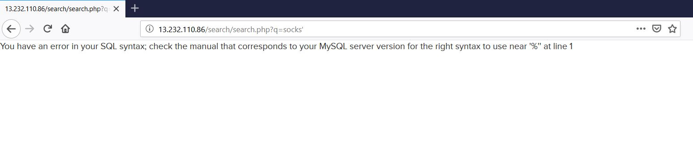
Observation
We apply single quote in house parameter: search.php?q=socks’ and we get complete MySQL error:

Slide 9
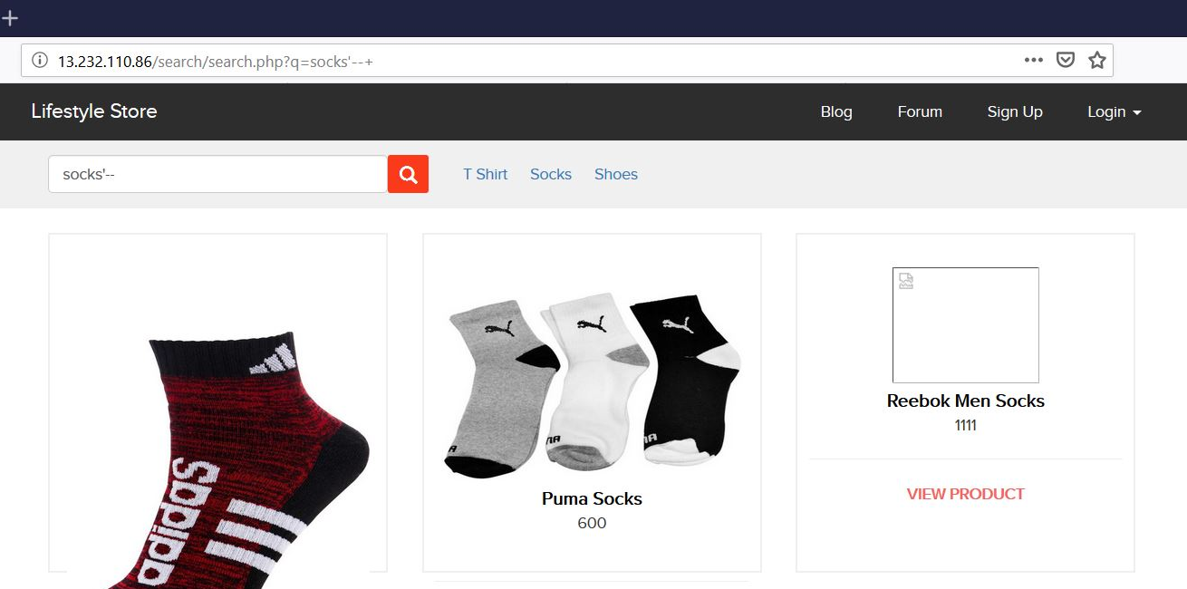
Observation
We then put --+ : search.php?q=socks’--+ and we error is removed confirming SQL injection:

Slide 10
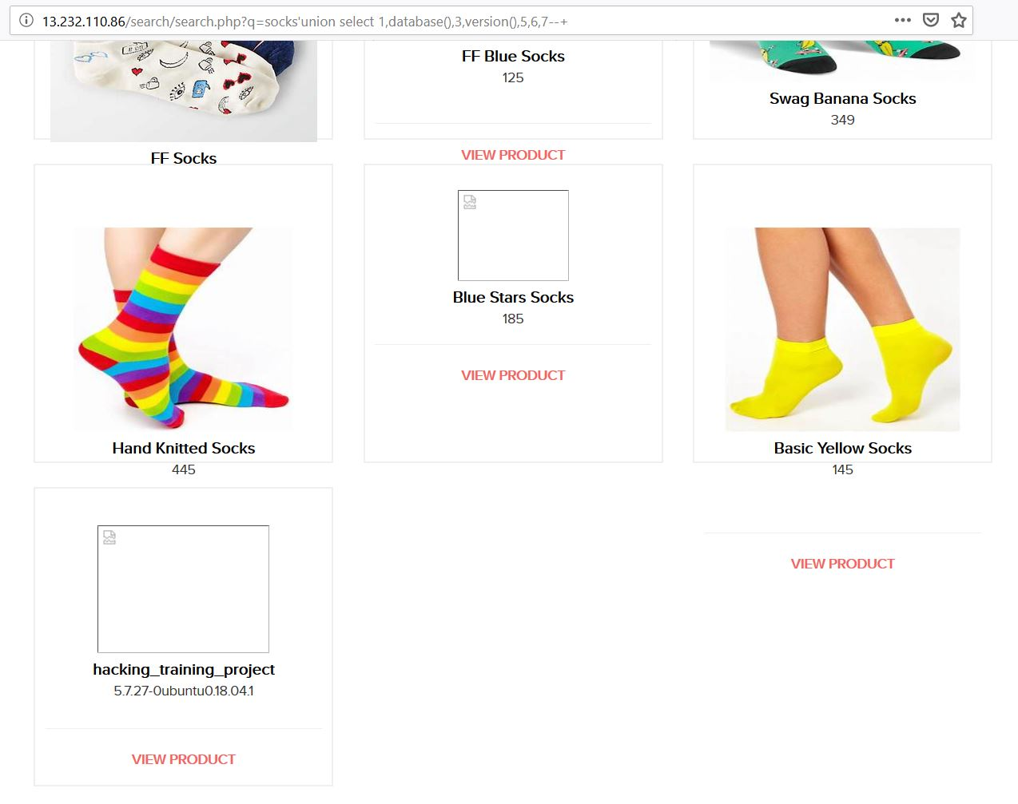
Proof of Concept (PoC)
Attacker can execute SQL commands as shown below. Here we have used the payload below to extract the database name and MySQL version information: q=socks'union select 1,database(),3,version(),5,6,7--+

Slide 11
PoC – Attacker can dump arbitrary data
No of databases: 2
[*] hacking_training_project
[*] information_schema
No of tables in hacking_training_project: 10
brands
cart_items
categories
customers
order_items
orders
product_reviews
products
sellers
users

Slide 12
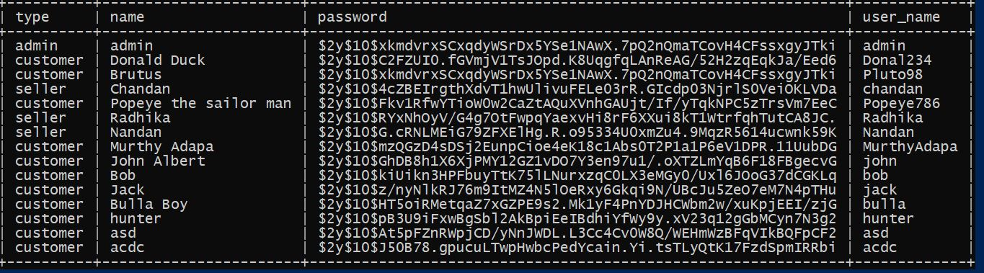
Business Impact – Extremely High
Using this vulnerability, attacker can execute arbitrary SQL commands on Internshala server and gain complete access to internal databases along with all data inside it.
Below is the screenshot of users table which shows user credentials being leaked that too in plain text with any hashing/encryption in password field.
Attacker can use this information to login to customer account and cancel his/her orders or order some unwanted items.

Slide 13
Recommendation
Take the following precautions to avoid exploitation of SQL injections:
Whitelist User Input: Whitelist all user input for expected data only. For example if you are expecting a product name in search box, limit it to alphabets only upto 20 characters in length. If you are expecting some ID, restrict it to numbers only
Prepared Statements: Use SQL prepared statements available in all web development languages and frameworks to avoid attacker being able to modify SQL query
Character encoding: If you are taking input that requires you to accept special characters, encode it. Example. Convert all ‘ to \’ , “ to \”, \ to \\. It is also suggested to follow a standard encoding for all special characters such has HTML encoding, URL encoding etc
Do not run Database Service as admin/root user
Disable/remove default accounts, passwords and databases
Assign each Database user only the required permissions and not all permissions

Slide 14
References
https://www.owasp.org/index.php/SQL_Injection
https://en.wikipedia.org/wiki/SQL_injection

Slide 15
2. Default /Weak Passwords
Access to Seller Dashboard (Critical) | The Sales dashboard at the below mentioned URL has default/weak password allowing complete admin access Affected URL : http://13.232.110.86/login/seller.php Affected Parameters : Username, password (POST parameters) Payload: Username=Radhika password=Radhika123

Slide 16
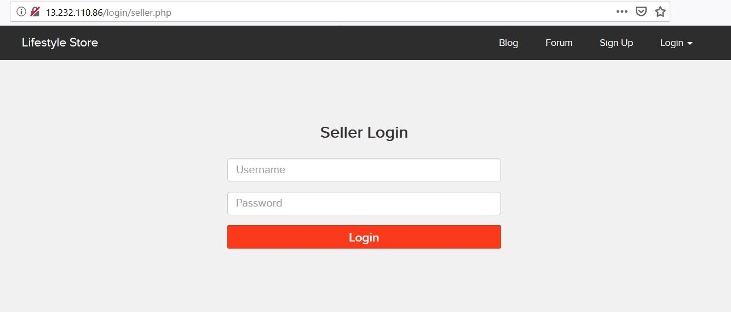
Observation
Navigate to http://13.232.110.86/login/seller.php You will see sales admin login page

Slide 17
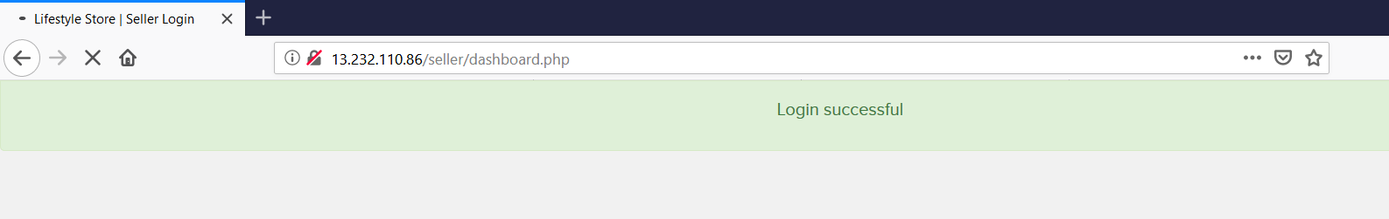
Observation
Enter username: Radhika & password: Radhika123. You will get loggedin to the sellers panel

Slide 18
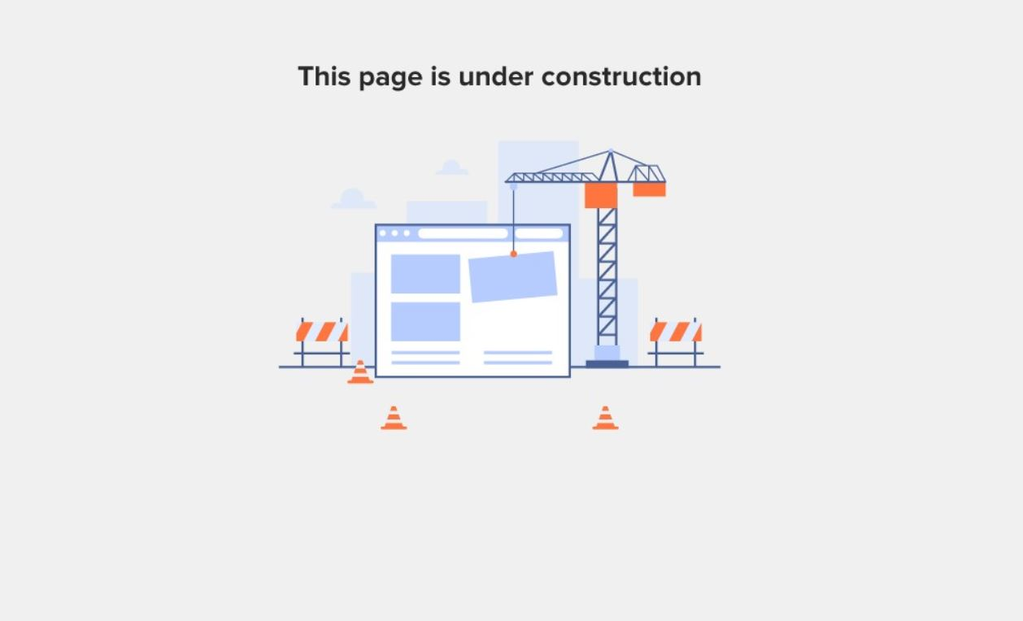
Business Impact – Low
Since The Page Is Under Construction Yet Its Impact is Not Much.

Slide 19
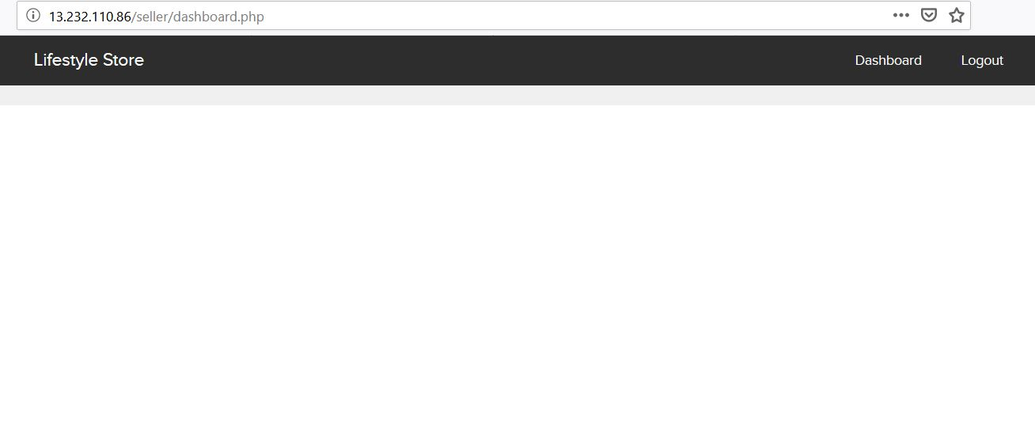
POC

Slide 20
2. Default /Weak Passwords
Access to Admin Panel Of ovidentiaCMS (Critical) | The Sales dashboard at the below mentioned URL has default/weak password allowing complete admin access Affected URL : http://13.232.110.86/ovidentiaCMS/index.php?tg=login&cmd=authform&msg=Connexion&err=&restricted=1 Affected Parameters : nickname, password (POST parameters) Payload: Identifier=admin@admin.bab password=012345678

Slide 21
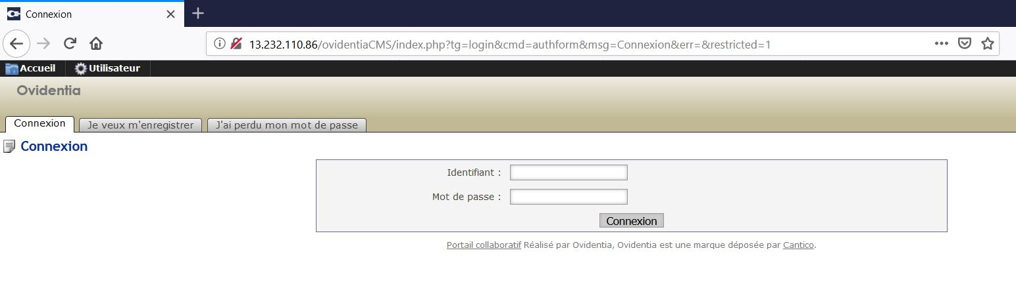
Observation
Navigate to http://13.232.110.86/ovidentiaCMS/index.php?tg=login&cmd=authform&msg=Connexion&err=&restricted=1 You will see sales admin login page

Slide 22
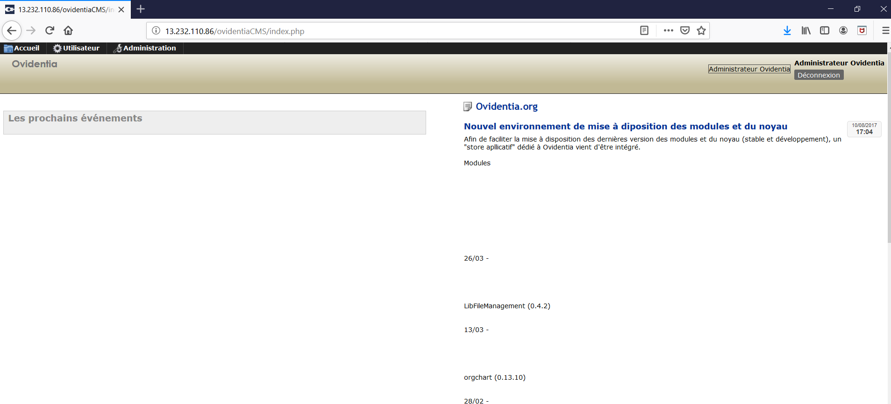
Observation
Enter username: admin@admin.bab & password: 012345678. You will get loggedin to the admin panel

Slide 23
Business Impact – High
A malicious user can access the admin panel which discloses many critical
information of organization including:
Users
Groups
Statitics
Sites
Forum
Directories
Add/Remove program
Diary
And Much More…………………….

Slide 24
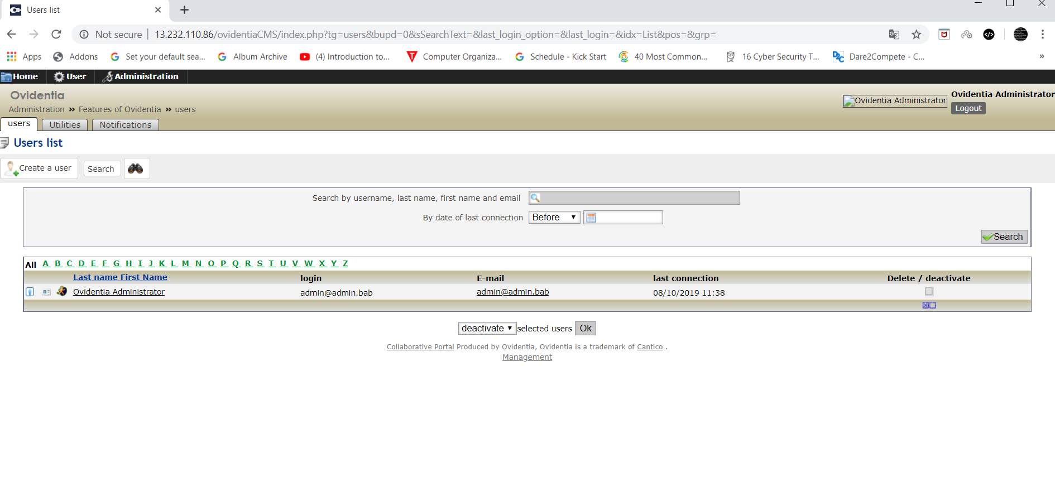
POC

Slide 25
Recommendation
Take the following precautions:
Use a strong password 8 character or more in length with alphanumerics and symbols
It should not contain personal/guessable information
Do not reuse passwords
Disable default accounts and users
Change all passwords to strong unique passwords
References:
https://www.owasp.org/index.php/Testing_for_weak_password_change_or_reset_functionalities_(OTG-AUTHN-009)
https://www.owasp.org/index.php/Default_Passwords
https://www.us-cert.gov/ncas/alerts/TA13-175A

Slide 26
3. Bruteforcing Attack
Account Takeover Using OTP Bypass (Critical) | The below mentioned login page allows login via OTP which can be bruteforced Affected URL : http://13.232.110.86/reset_password/admin.php Affected Parameters : otp (GET parameters)

Slide 27
3. Bruteforcing Attack
Applying Discount Coupan (Critical) | Other URL which can be bruteforced. Affected URL : http://13.232.110.86/cart/cart.php (When Added Some Items In Cart) Affected Parameters : coupon (POST parameters)

Slide 28
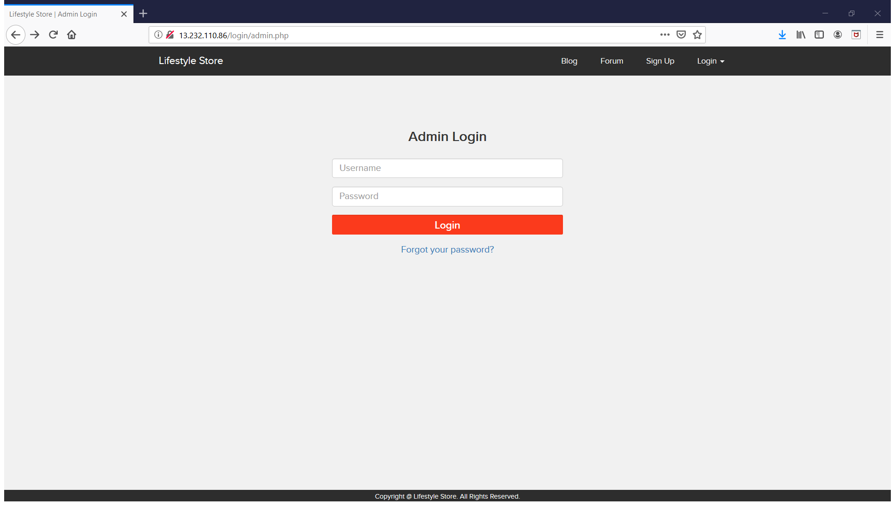
Observation
Navigate to http://13.232.110.86/login/admin.php You will see user login page of Admin. Nothing to enter,Simply Click Forgot password.

Slide 29
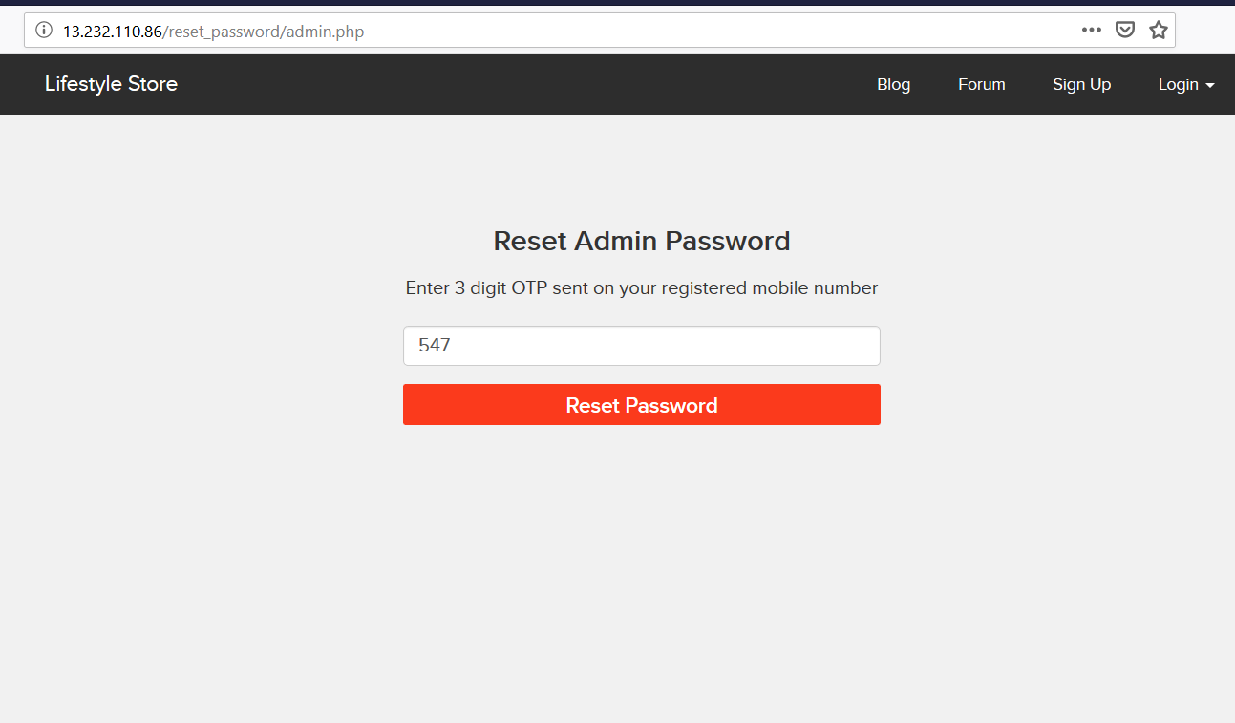
Observation
Navigated to http://13.232.110.86/reset_password/admin.php You will see An OTP has been generated for account recovery.

Slide 30
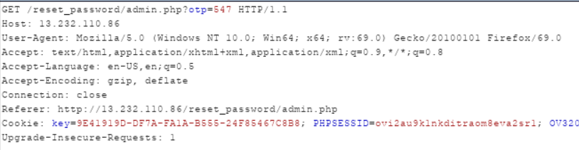
Observation
Following request will be generated containing OTP parameter.

Slide 31
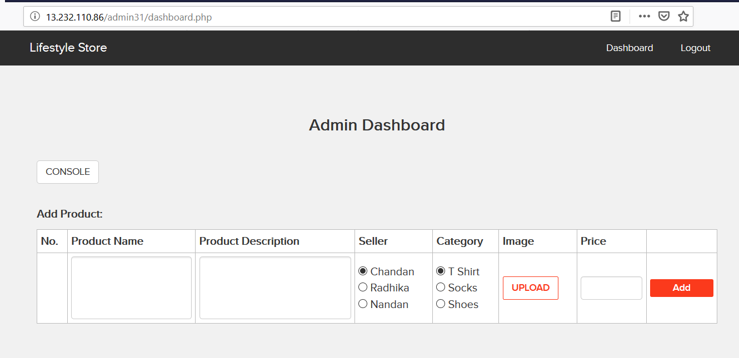
Business Impact – Extremely High
A malicious hacker can gain complete access to any account just by knowing nothing. This leads to complete compromise of personal user data of every customer.
Attacker once logs in can then carry out actions on behalf of the victim which could lead to serious financial loss to him/her.

Slide 32
Recommendation
Take the following precautions:
Use proper ratelimiting checks on the no of OTP checking and Generation requests
Implement anti-bot measures such as ReCAPTCHA after multiple incorrect attempts
OTP should expire after certain amount of time like 2 minutes
OTP should be atleast 6 digit and alpha numeric for more security
References:
https://www.owasp.org/index.php/Testing_Multiple_Factors_Authentication_(OWASP-AT-009)
https://www.owasp.org/index.php/Blocking_Brute_Force_Attacks

Slide 33
4. Insecure Direct Object Referance(IDOR)
Unauthorised Access to Customer’s Order History (Severe) | The Show My Bill module suffers from an Insecure Direct Object Reference (IDOR) that allows attacker get access to anyones Bill details Affected URL : http://13.232.110.86/orders/orders.php?customer=2 Affected Parameters : customer (GET parameters) Affected URL : http://13.232.110.86/products/details.php?p_id=5 Affected Parameters : p_id (GET parameters)

Slide 34
4. Insecure Direct Object Referance
Unauthorised Access to Customer Details (Severe) | Similar issue is found on below URL too:- Affected URL : http://13.232.110.86/forum/index.php?u=/user/profile/5 Affected Parameters : u (GET parameter)

Slide 35
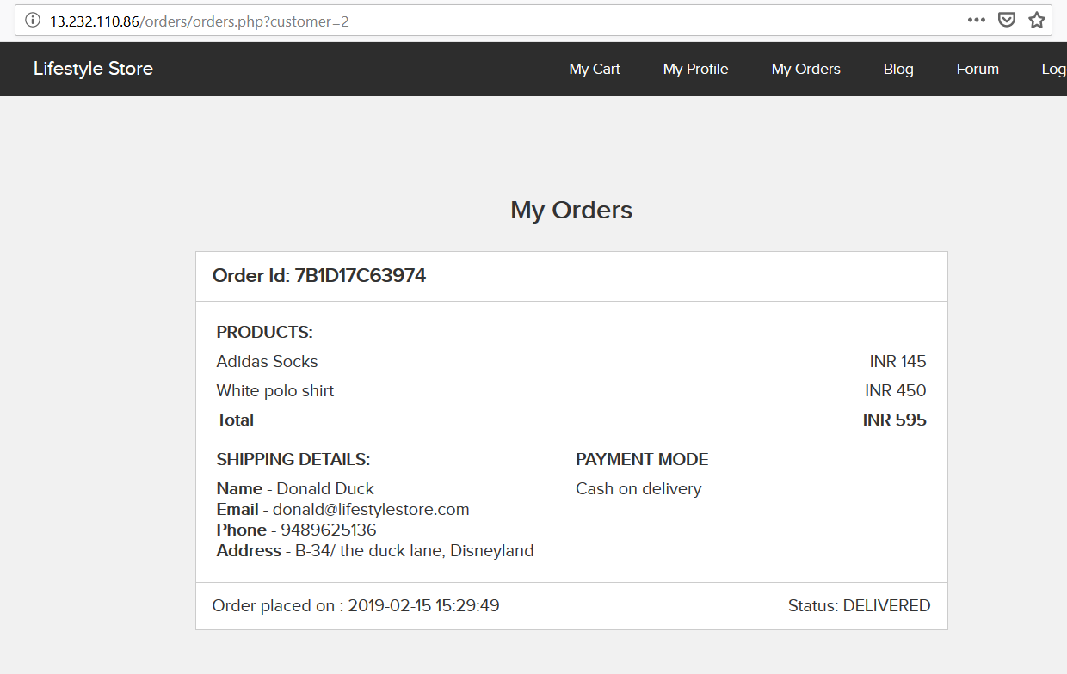
Observation
Login to your account and navigate to My Orders on http://13.232.110.86/orders/orders.php?customer=2
It contains Emai-id, Phone No.,Address of our user.

Slide 36
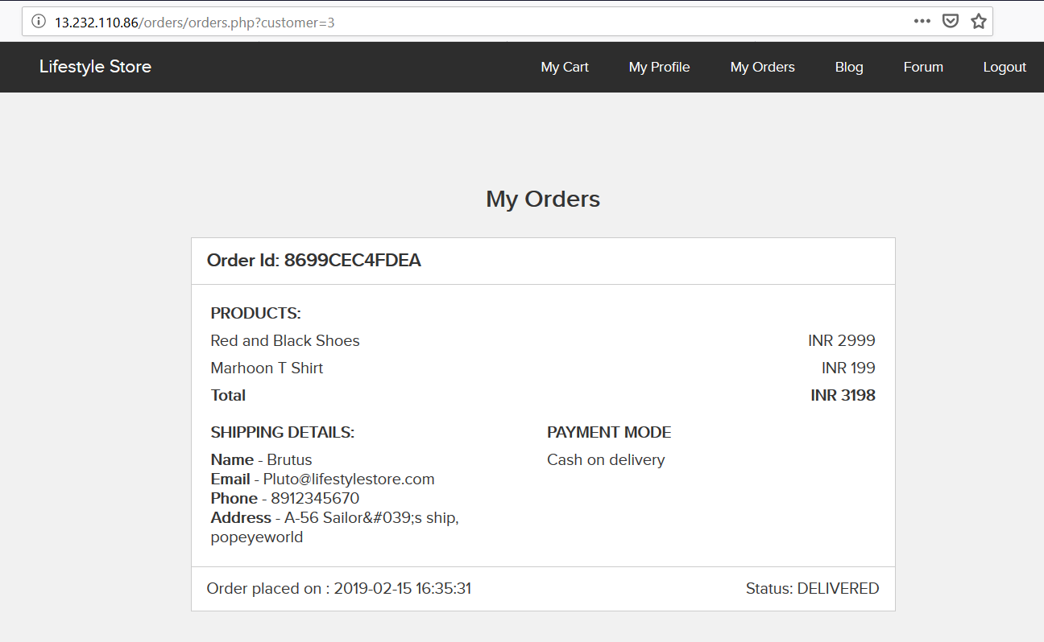
Observation
We change this customer value from 2 to 3 and we get order history of a different user with critical info.

Slide 37
Business Impact – Extremely High
A malicious hacker can read order history of any user just by knowing the Any Parameter. This discloses critical billing information of users including:
Mobile Number
Email Id
Order Id
Order Amount,Product
Address
This can be used by malicious hackers to carry out targeted phishing attacks on the users and the information can also be sold to competitors/blackmarket.
More over, as there is no ratelimiting checks, attacker can bruteforce the user_id for all possible values and get all information of each and every user of the organization resulting is a massive information leakage.
Other IDORs on the application are leaking much more information including Payment details, order history and even allow attacker to perform other attacks.

Slide 38
Recommendation
Take the following precautions:
Implement proper authentication and authorisation checks to make sure that the user has permission to the data he/she is requesting
Use proper ratelimiting checks on the number of request comes from a single user in a small amount of time
Make sure each user can only see his/her data only.
References:
https://www.owasp.org/index.php/Insecure_Configuration_Management
https://www.owasp.org/index.php/Top_10_2013-A4-Insecure_Direct_Object_References

Slide 39
5. Cross Site Scripting (XSS)
Permanent Cross Site Scripting (Critical) | Below mentioned parameters are vulnerable to Permanent XSS Affected URL : 13.232.110.86/products/details.php?p_id=6 Affected Parameters : comment(POST parameters) Payload: <script>alert(“It’s a Permanent XSS”)</script>

Slide 40
5. Cross Site Scripting (XSS)
Temprory Cross Site Scripting (Critical) | Similar issue is found on below modules too Affected URL : http://13.232.110.86/profile/2/edit/ Affected Parameters : address – (POST Parameter) Payload: <script>alert("This is Temprory XSS")</script>

Slide 41
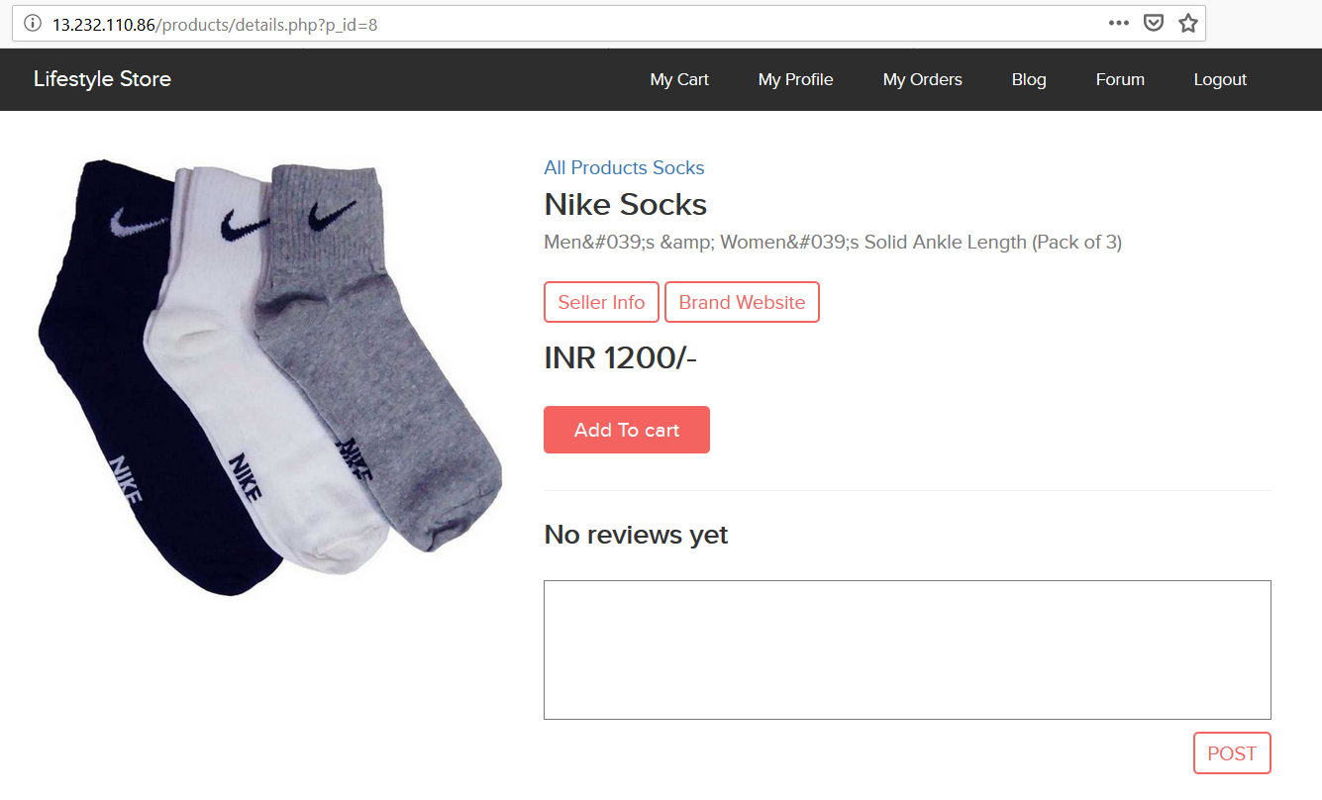
Observation
Navigate to http://13.232.110.86/products/details.php?p_id=8
You will see Reviews to enter for product.

Slide 42
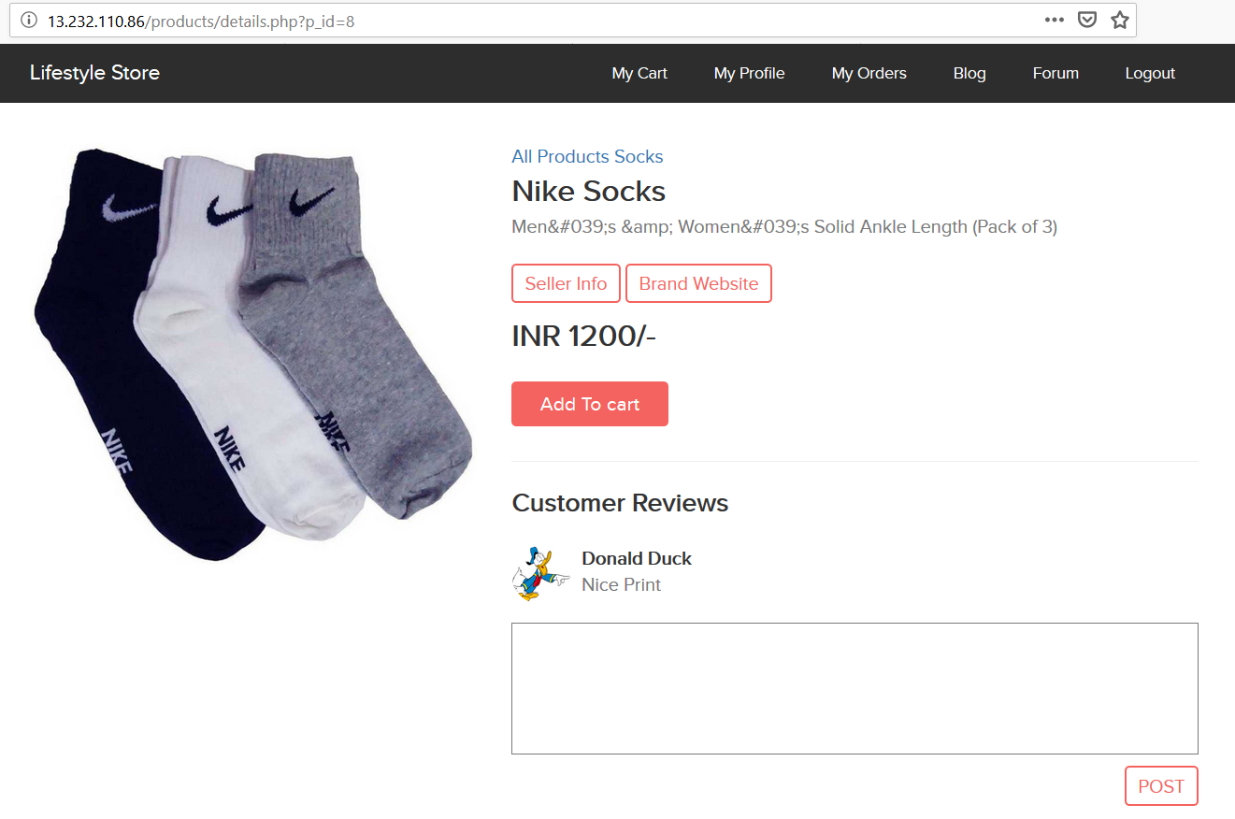
Observation
Enter any text in reviews and click the button post, you will see it reflected in the next page and value will be in POST parameter comment.

Slide 43
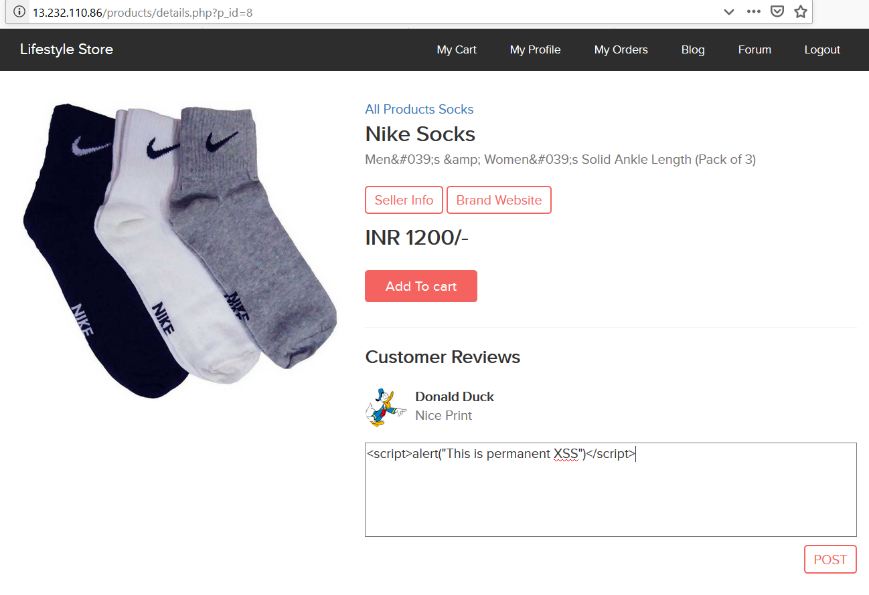
Observation
Put the payload instead of Nice Print: <script>alert(“This is permanent XSS”)</script>
As you can see we executed custom JS causing popup

Slide 44
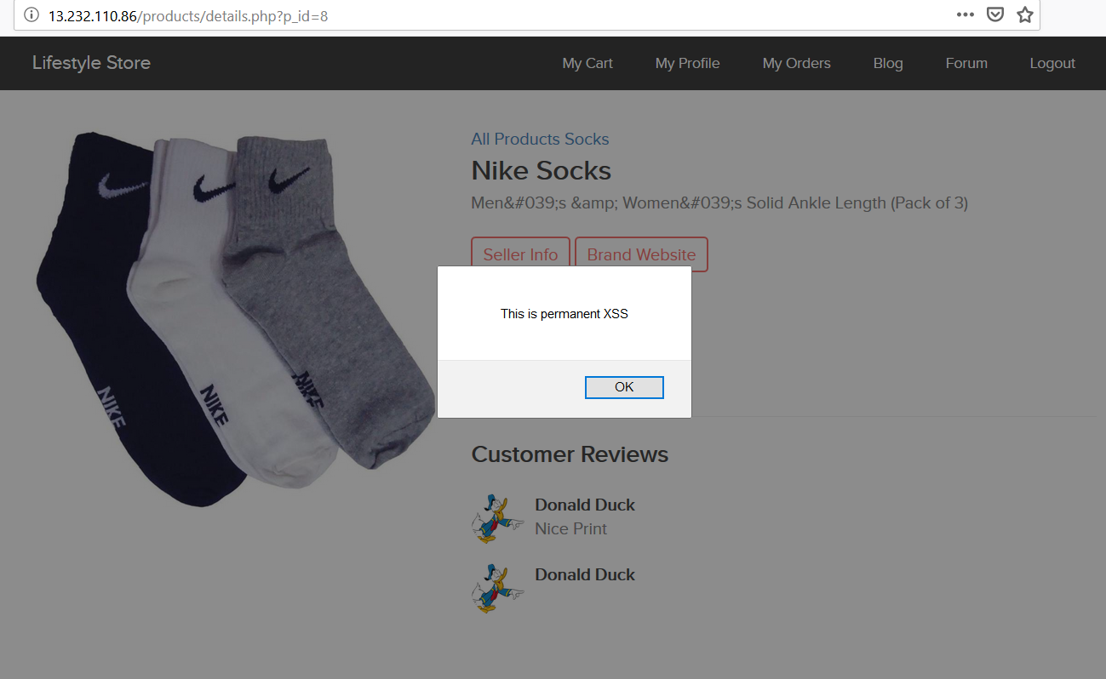
PoC

Slide 45
Business Impact – High
As attacker can inject arbitrary HTML CSS and JS via the URL, attacker can put any content on the page like phishing pages, install malware on victim’s device and even host explicit content that could compromise the reputation of the organization
All attacker needs to do is send the link with the payload to the victim and victim would see hacker controlled content on the website. As the user trusts the website, he/she will trust the content.

Slide 46
Recommendation
Take the following precautions:
Sanitise all user input and block characters you do not want
Convert special HTML characters like ‘ “ < > into HTML entities &quot; %22 &lt; &gt; before printing them on the website
References:
https://www.owasp.org/index.php/Cross-site_Scripting_(XSS)
https://en.wikipedia.org/wiki/Cross-site_scripting
https://www.w3schools.com/html/html_entities.asp

Slide 47
6. Forced Browsing
Forced Browsing (Critical) | Below mentioned parameters are vulnerable to reflected XSS Affected URL : http://13.126.131.188/admin31/dashboard.php http://13.126.131.188/reset_password/customer.php

Slide 48
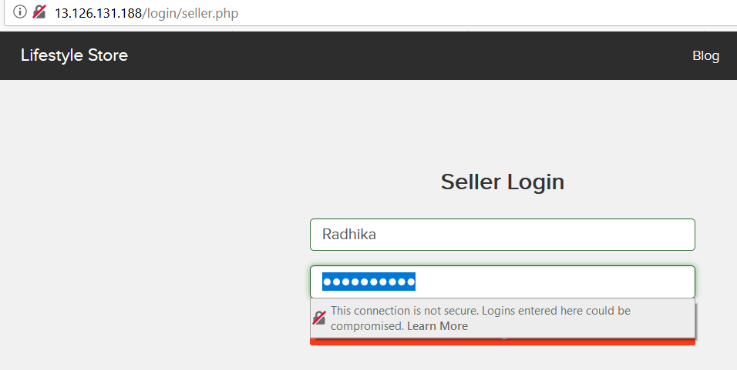
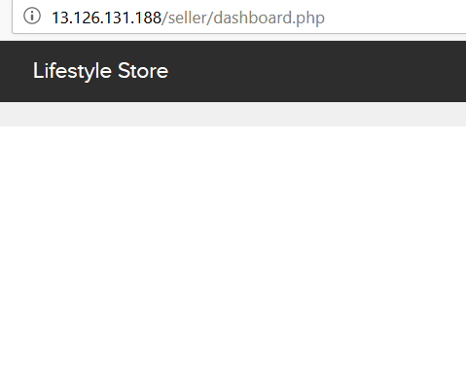
Observation
Navigate to http://http://13.126.131.188/login/seller.php
Login To Account using Following URL
Username:Radhika Password:Radhika123

Slide 49
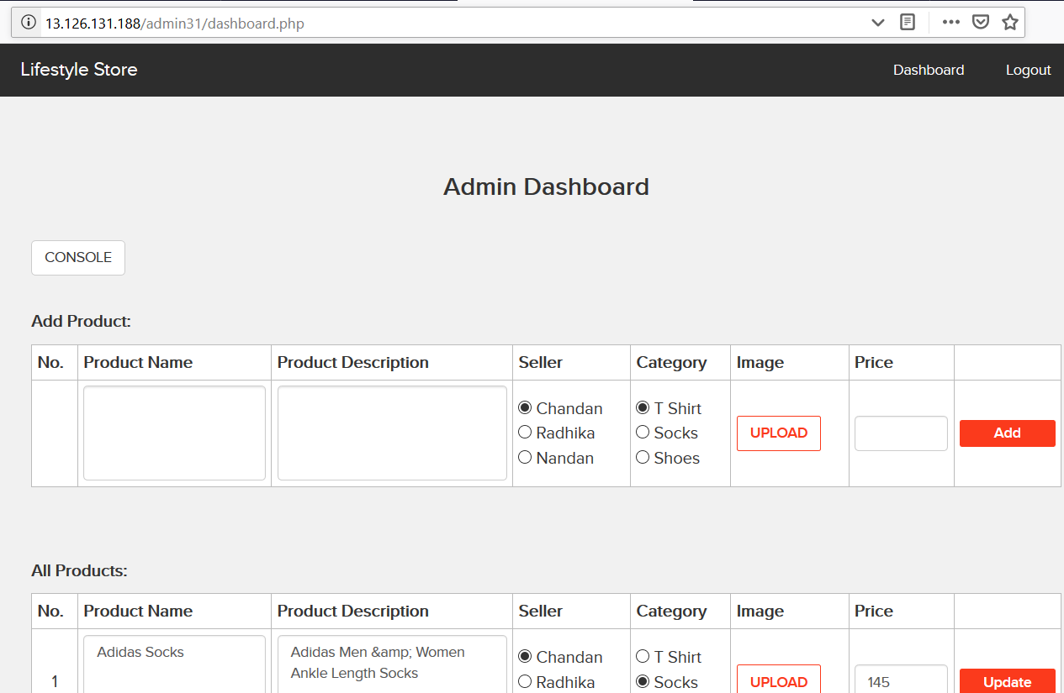
Observation
Paste the Admin Panel URL in URL Here http://13.126.131.188/admin31/dashboard.php

Slide 50
Business Impact – High
A malicious hacker can gain complete access to any account just by knowing nothing. This leads to complete compromise of personal user data of every customer.
Attacker once logs in can then carry out actions on behalf of the victim which could lead to serious financial loss to him/her.

Slide 51
Recommendation
Take the following precautions:
Proper Authentication Steps Should Be Followed
Proper Authorization Steps Should Be Followed
References:
https://www.owasp.org/index.php/Forced_browsing
https://campus.barracuda.com/product/webapplicationfirewall/doc/42049348/forceful-browsing-attack/

Slide 52
7. Default Files And Pages
Default Files And Pages (Severe) | Below mentioned urls disclose server information Affected URL : http://13.126.131.188/server-status/ http://13.126.131.188/robots.txt http://13.126.131.188/static/images/uploads http://13.126.131.188/[any_text]

Slide 53
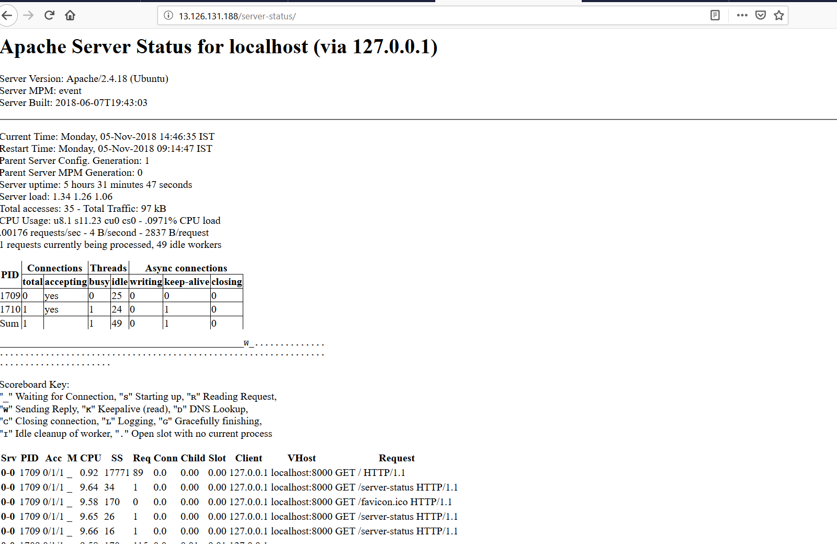
Observation
Navigate to mentioned URL
Default server-status page opens which discloses server information

Slide 54
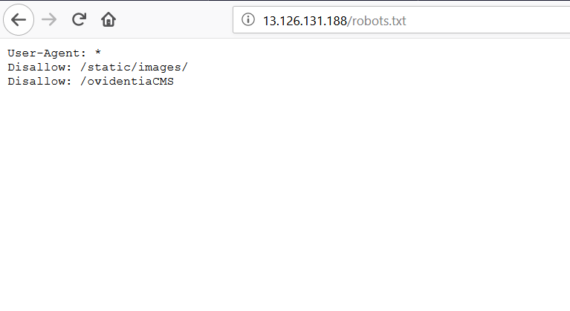
Observation
robots.txt File

Slide 55
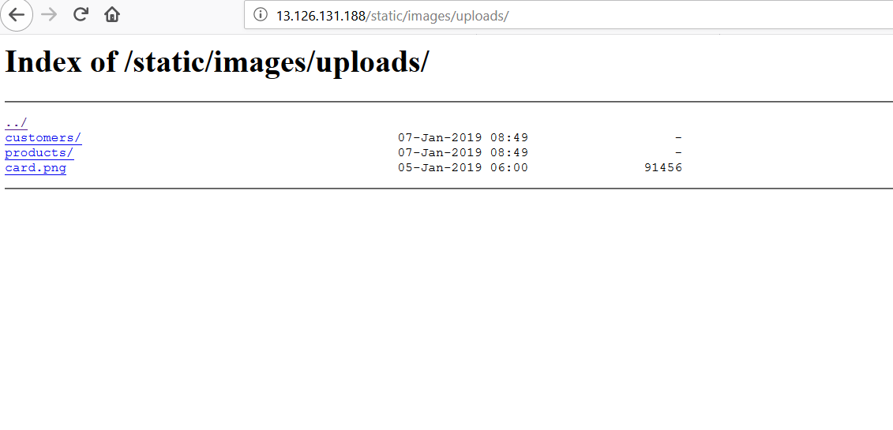
Observation
Static/images/uploads Page

Slide 56
Business Impact – Moderate
Although this vulnerability does not have a direct impact to users or the server, though it can help the attacker in mapping the server architecture and plan further attacks on the server
Recommendation
Take the following precautions:
Disable all default pages and folders including server-status and phpinfo.php
References:
https://vuldb.com/?id.88482
https://httpd.apache.org/docs/current/mod/mod_status.html
https://www.beyondsecurity.com/scan_pentest_network_vulnerabilities_apache_http_server_httponly_cookie_information_disclosure

Slide 57
8. Rate Limiting Flaw
Rate Limiting Flaw (Low) | Below mentioned urls are accessible without authentication from valid user:- Affected URL : http://13.126.131.188/cart/cart.php

Slide 58
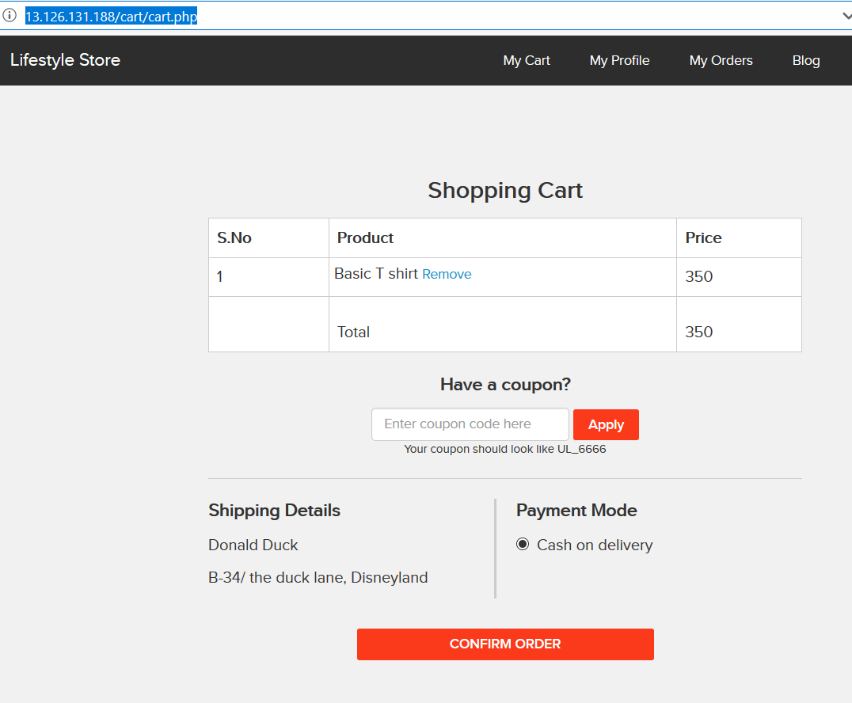
Observation
Navigate to mentioned URL
Apply Coupan Field Is Vunerable To Rate Limiting Flaw

Slide 59
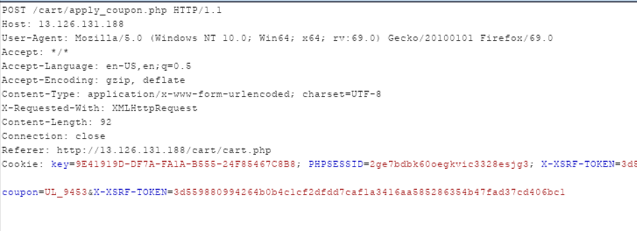
Observation
Look For A Parameter coupan in Header

Slide 60
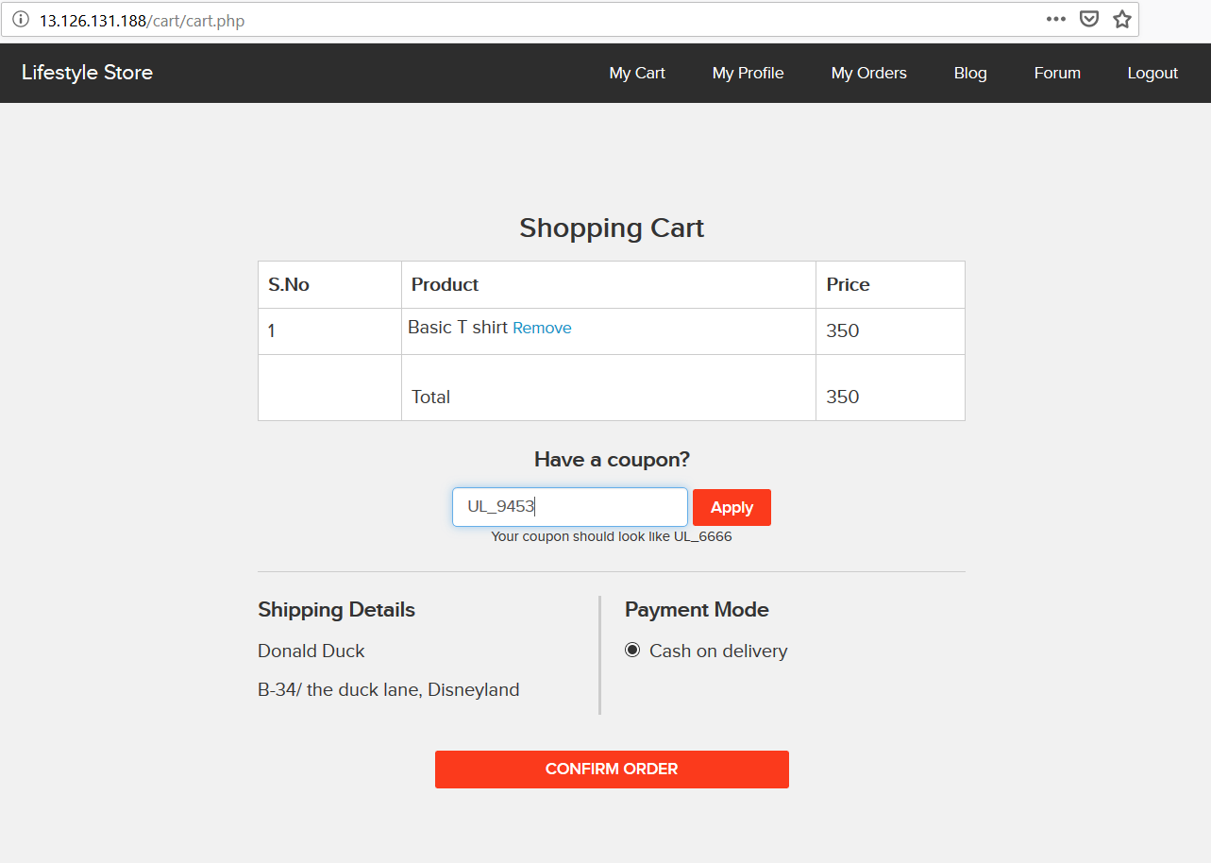
POC
Bruteforcing This Field parameter coupan

Slide 61
Business Impact – Moderate
Although this vulnerability does not have a direct impact to users or the server, though it can help the attacker to produce multiple requests att a time which may result in huge traffic at server and may let it down.
Recommendation
Take the following precautions:
Proper NO OF Attempts OR A Time Based Input Verifaction Should Be Done.
References:
https://support.portswigger.net/customer/portal/questions/17601490-rate-limit-bug
https://www.keycdn.com/support/rate-limiting

Slide 62
9. PII Leakage
PII Leakage (Severe) | Below mentioned urls disclose personal information Affected URL : http://13.126.131.188/products/details.php?p_id=5 http://13.126.131.188/login/customer.php http://13.126.131.188/wondercms/

Slide 63
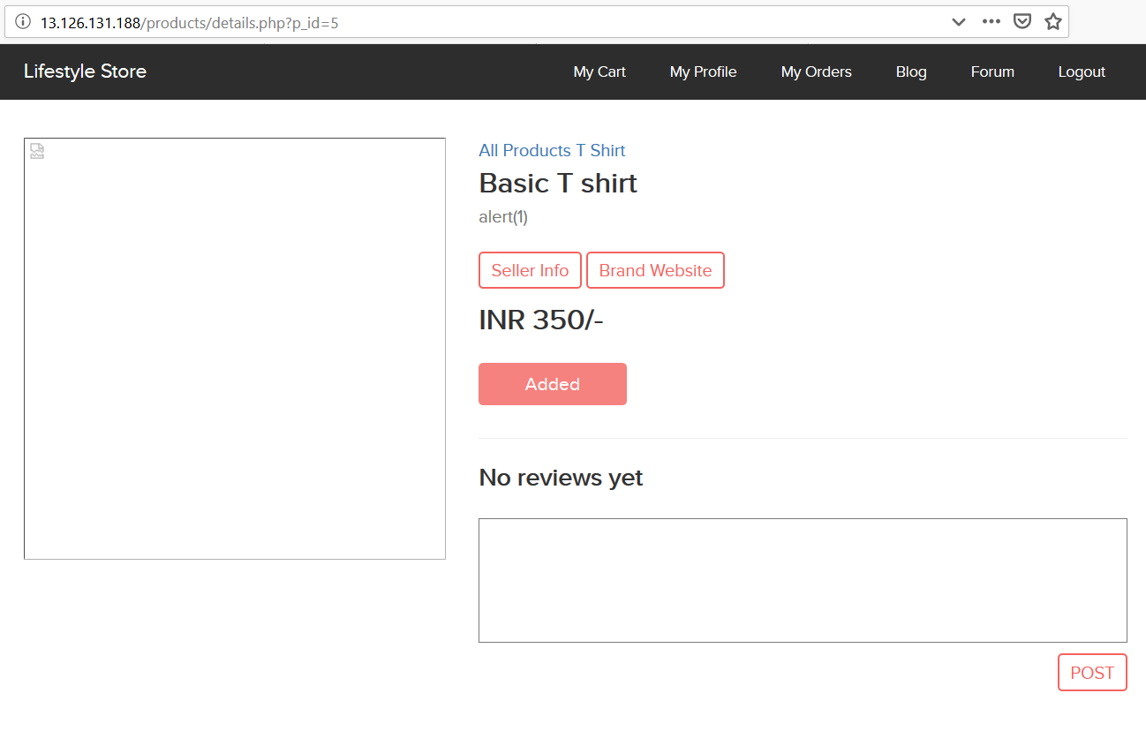
Observation
Navigate to mentioned URL And Click On Seller Info

Slide 64
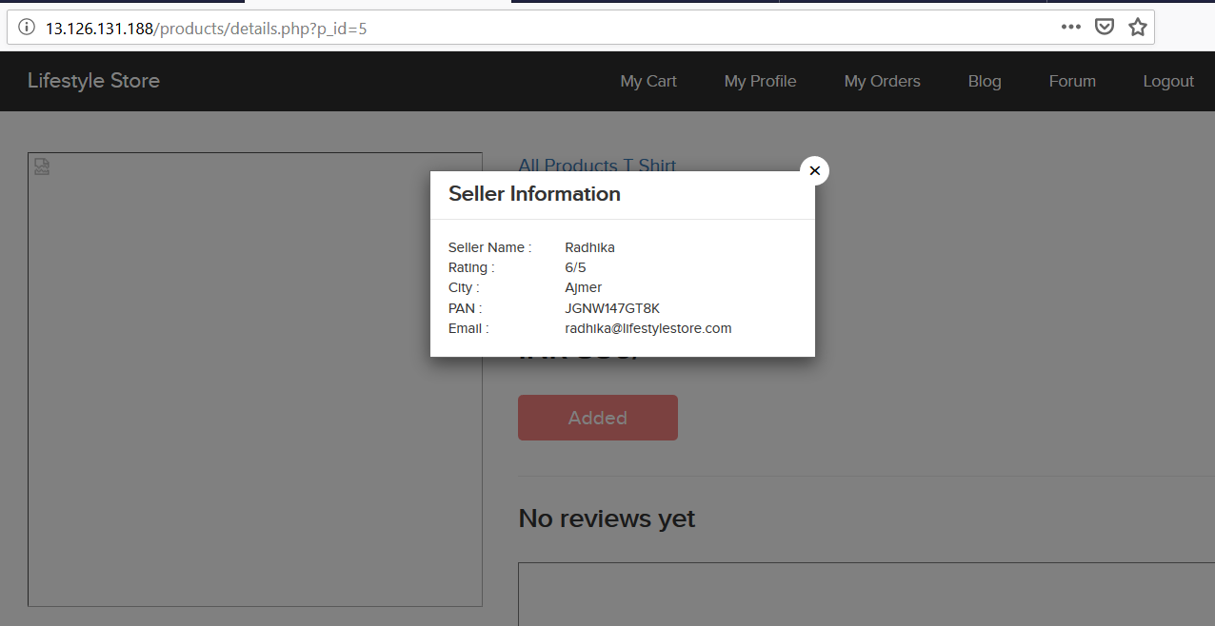
POC

Slide 65
Business Impact – Moderate
This vulnerability does not have a direct impact to users or the server, but it gives most of the information that is highly critical and is used for big attack.
Recommendation
Take the following precautions:
All the personal info should never be displayed directly.
References:
https://digitalguardian.com/blog/how-secure-personally-identifiable-information-against-loss-or-compromise
https://support.google.com/analytics/answer/6366371?hl=en

Slide 66
10. Open Re-direction
Open Redirection (Low) | Below mentioned urls redirects request to another url Affected URL : http://13.126.131.188/redirect.php?url=“URL”

Slide 67
Observation
Navigate to http://13.126.131.188/products/details.php?p_id=5 And Click On Brand Website

Slide 68
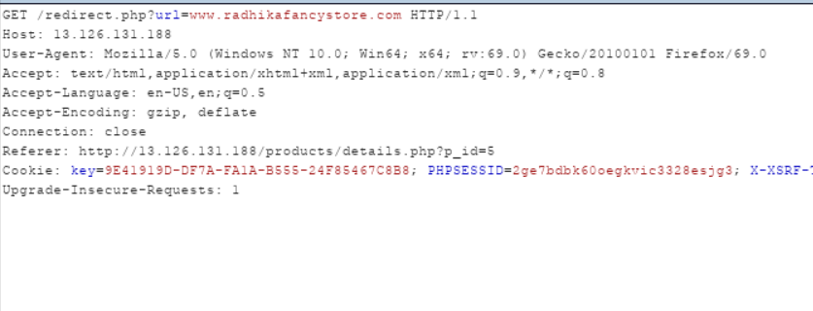
Observation
Intercept The Request And Change Redirection URL ie url parameter from www.radhikafancystore.com to www.google.com

Slide 69
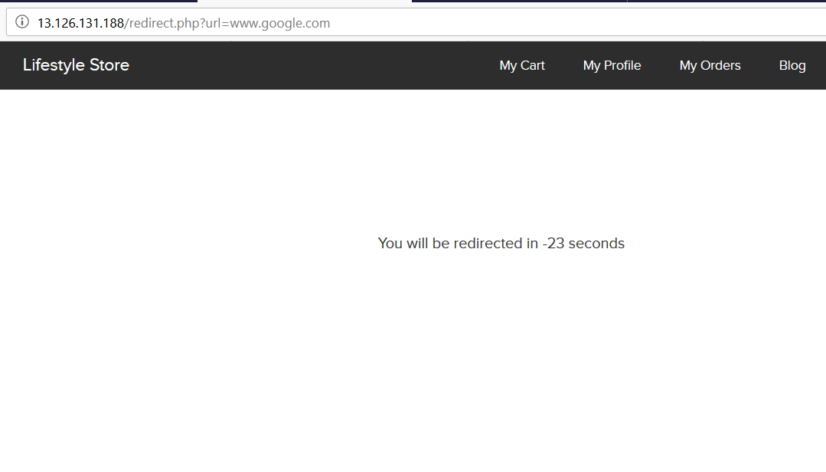
POC

Slide 70
Business Impact – Moderate
This Will never Stop And Its Request Will go On and such Multiple Requests May Down The Server.
Recommendation
Take the following precautions:
Redirection URL Should Be accessible and must bounded by time.
References:
https://cwe.mitre.org/data/definitions/601.html
https://dzone.com/articles/what-is-an-open-redirection-vulnerability-and-how

Slide 71
11. Command Execution Vunerability
Command Execution (Severe) | Below mentioned urls redirects to pages allowing command execution Affected URL : http://13.126.131.188/wondercms/ http://13.126.131.188/admin31/console.php

Slide 72
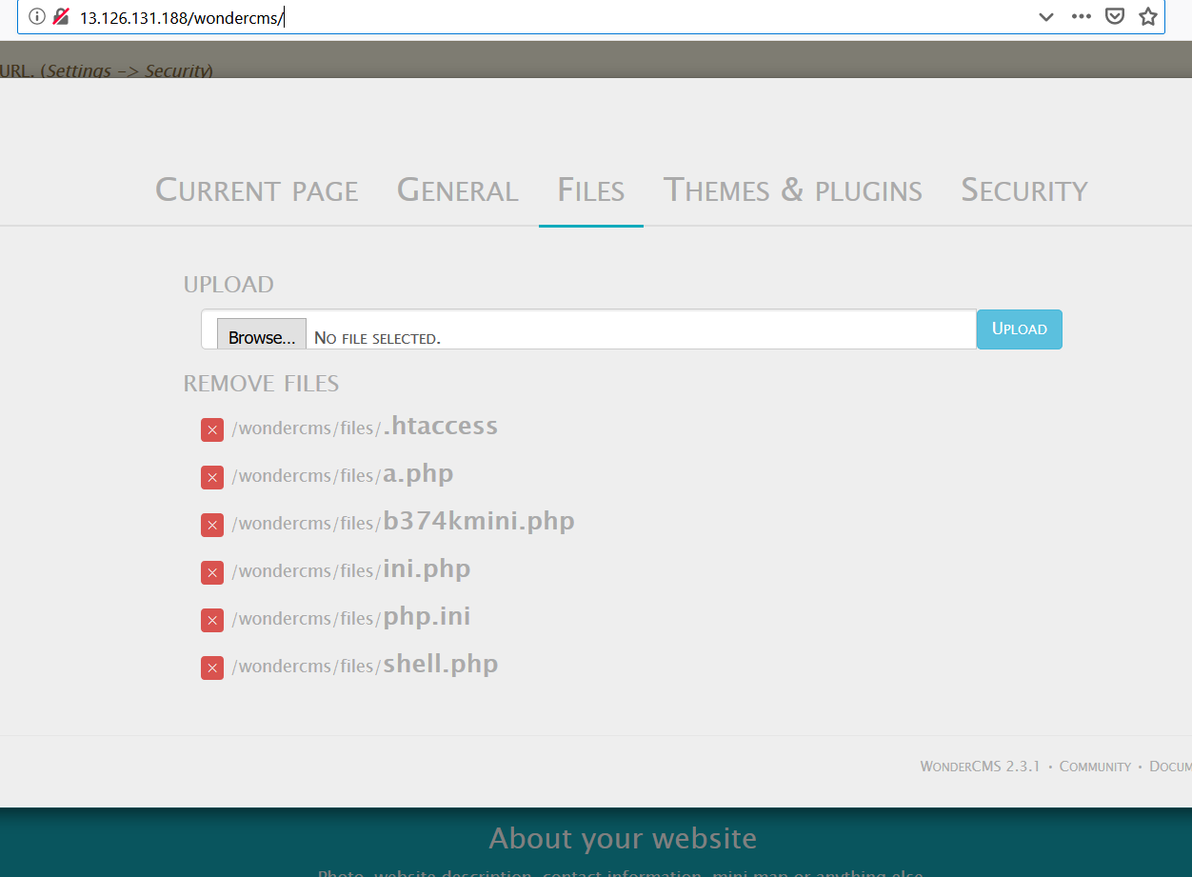
Observation
Navigate to http://13.126.131.188/wondercms/And login to admin panel and Click Settings

Slide 73
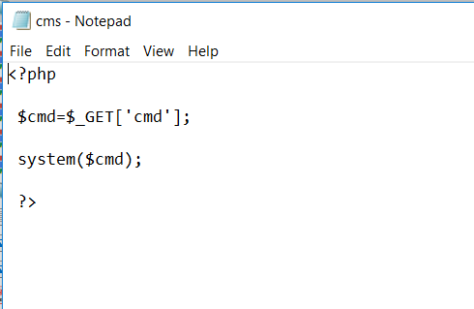
POC Upload Following File As cms.php

Slide 74
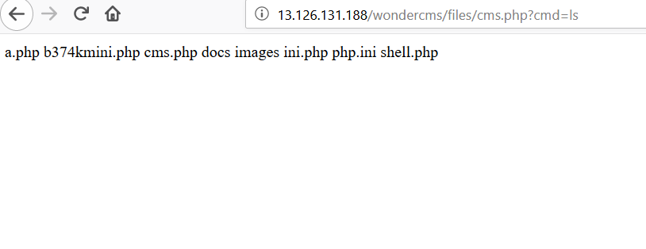
Business Impact – Moderate
Open The file cms.php and navigate to Url /wondercms/files/cms.php and add ?cmd=ls

Slide 75
Recommendation
Take the following precautions:
Appending URL with other values should be restricted.
References:
https://www.owasp.org/index.php/Command_Injection
https://www.netsparker.com/blog/web-security/command-injection-vulnerability/

Slide 76
12. File Inclusion Vunerability
File Inclusion Vunerability (Severe) | Below mentioned urls allows to upload some critical files Affected URL : http://13.126.131.188/wondercms/

Slide 77
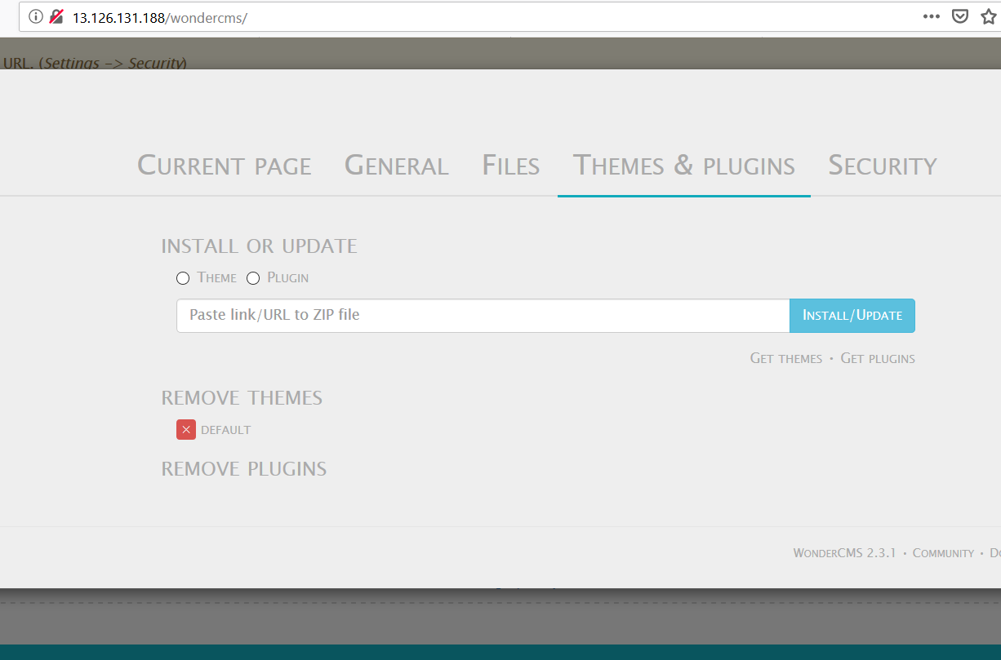
Observation
Navigate to http://13.126.131.188/wondercms/ And login to admin and Click On Settings ->Themes And Plugins

Slide 78
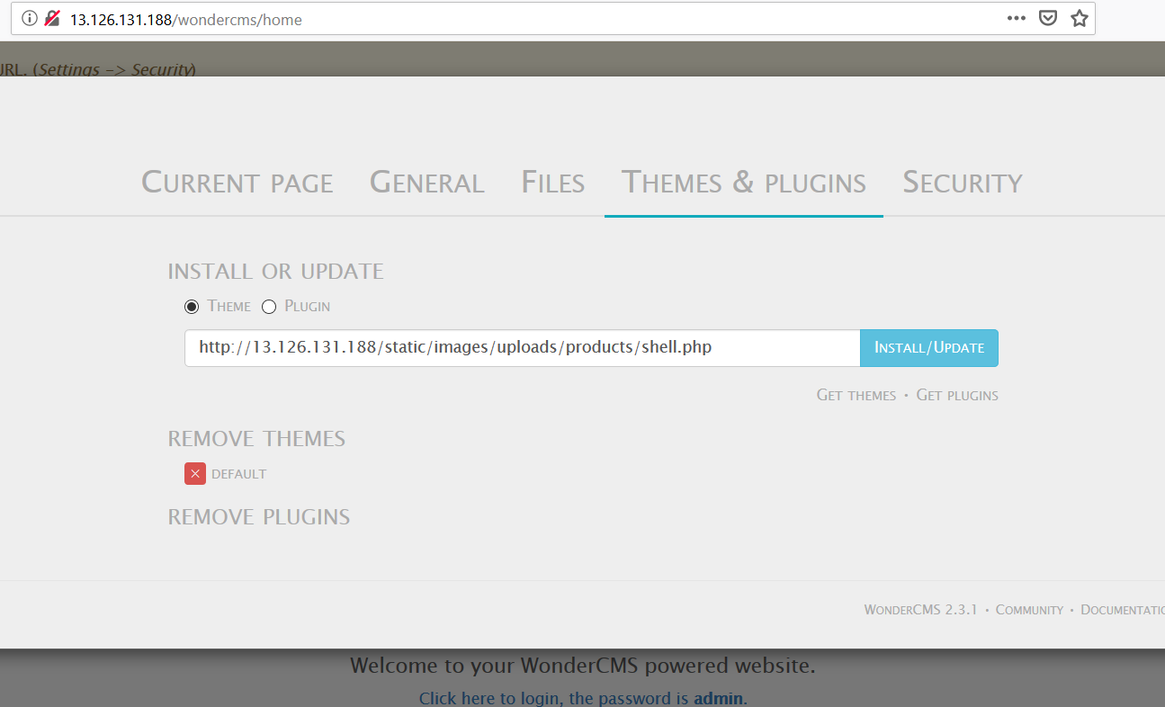
Observation
Upload URL OF A File Present on server as Theme

Slide 79
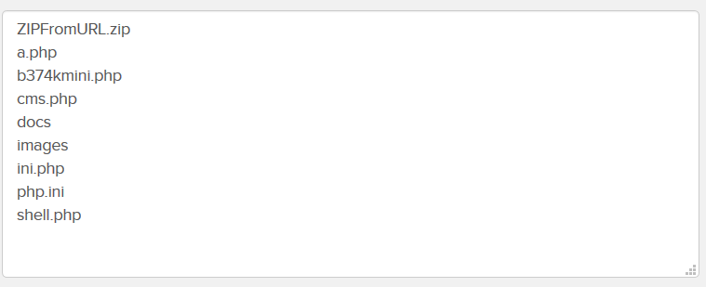
POC
Contents Of /wondercms/files our file has been uploaded.

Slide 80
Business Impact – Moderate
We Can Upload Any Kind Of File Here And Thus Backdoor Creation Easy .
Recommendation
Take the following precautions:
Proper File Format Along With Multiple Checks Should Be Implemented.
References:
https://www.owasp.org/index.php/Testing_for_Local_File_Inclusion
https://www.netsparker.com/blog/web-security/local-file-inclusion-vulnerability/

Slide 81
13. Insecure File Upload Vunerability
Insecure File Upload (Critical) | Below mentioned urls are vunerable to file upload Affected URL : http://13.126.131.188/profile/2/edit/ http://13.126.131.188/admin31/dashboard.php http://13.126.131.188/ovidentiaCMS/index.php?tg=users&idx=Create&pos=A&grp= http://13.126.131.188/forum/index.php?u=/user/profile/26/edit

Slide 82
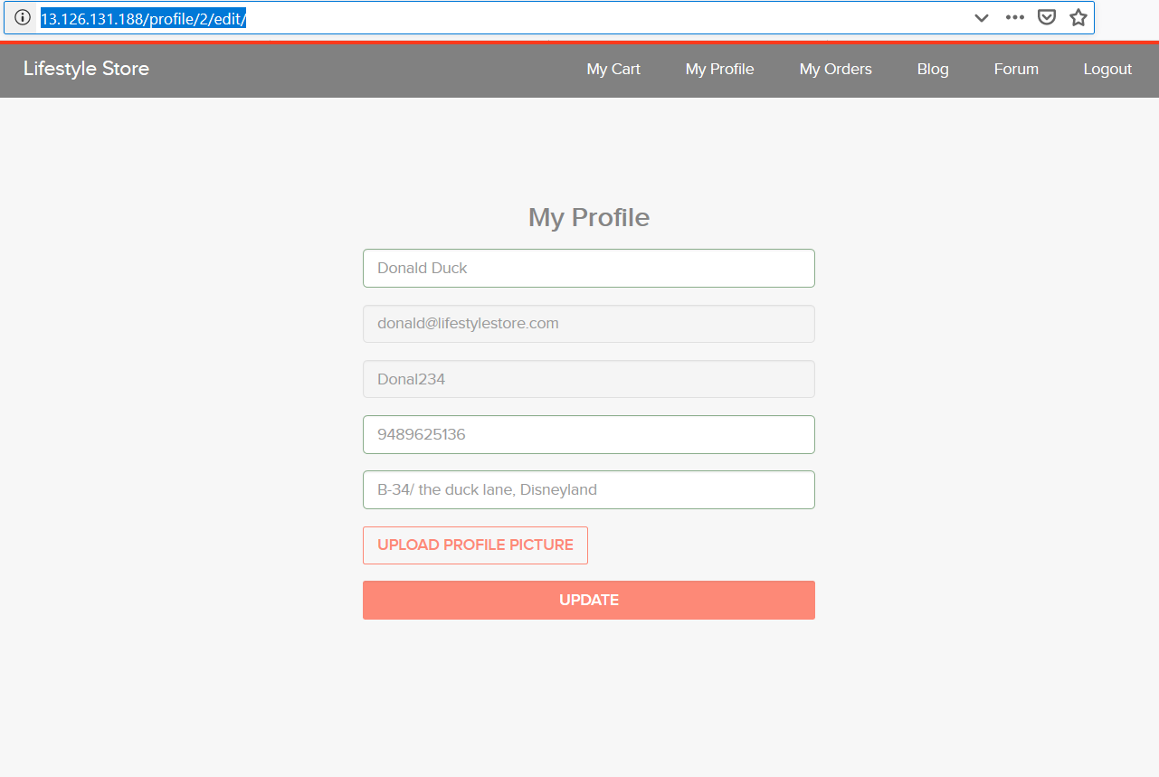
Observation
Navigate to http://13.126.131.188/profile/2/edit/ After logging Into your Account

Slide 83
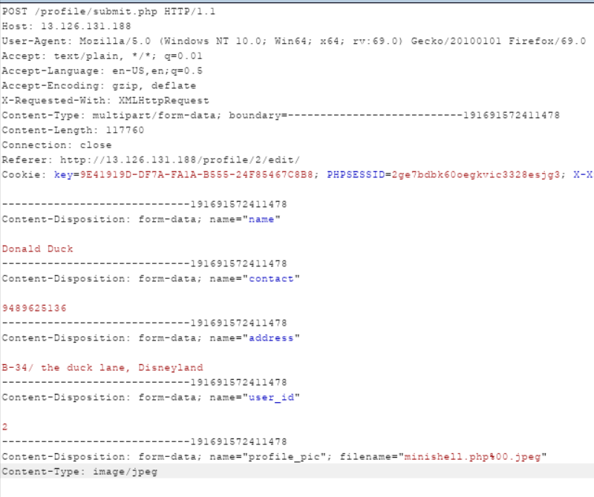
Observation
Upload A PHP And Intercept The Request and change file.php to file.php%00.jpeg and content type to image/jpeg

Slide 84
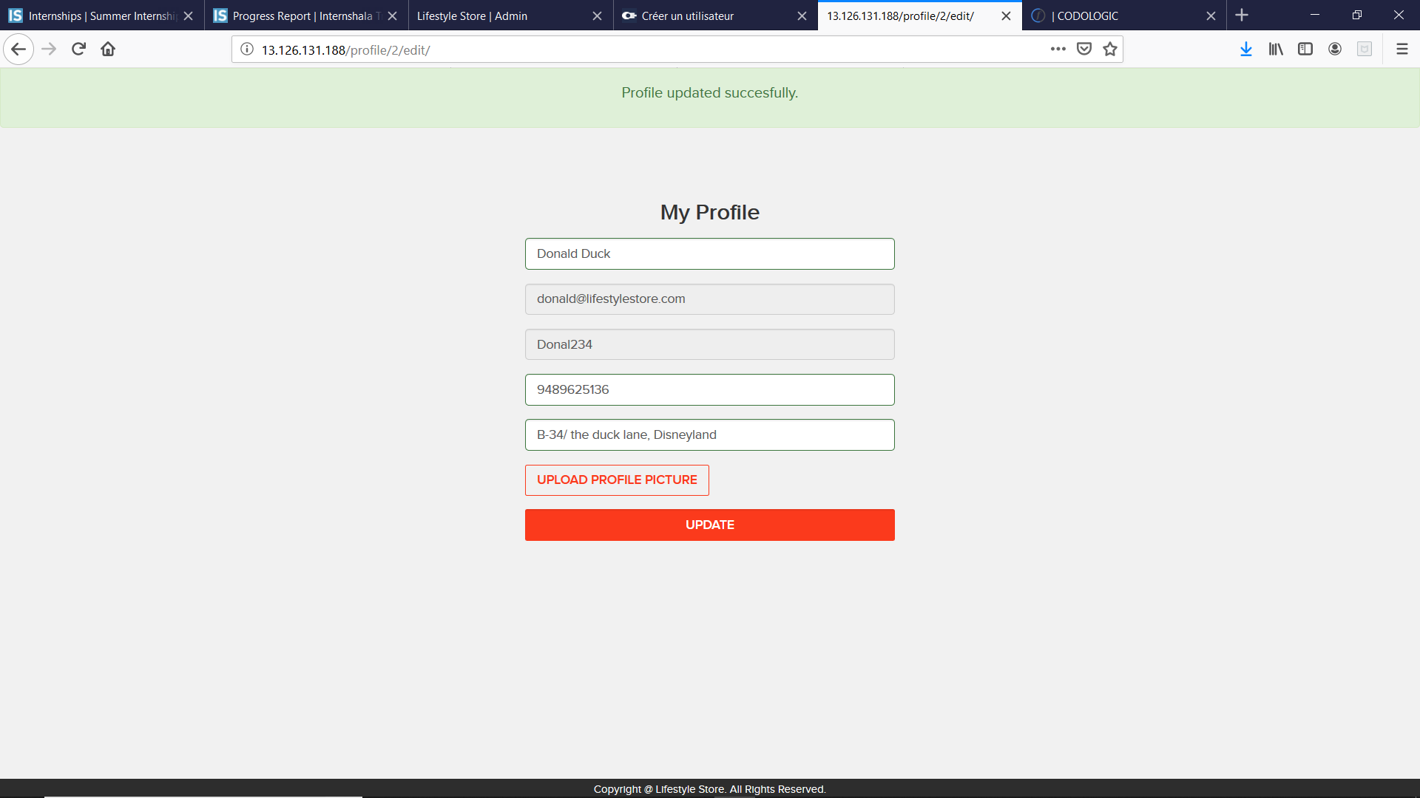
POC

Slide 85
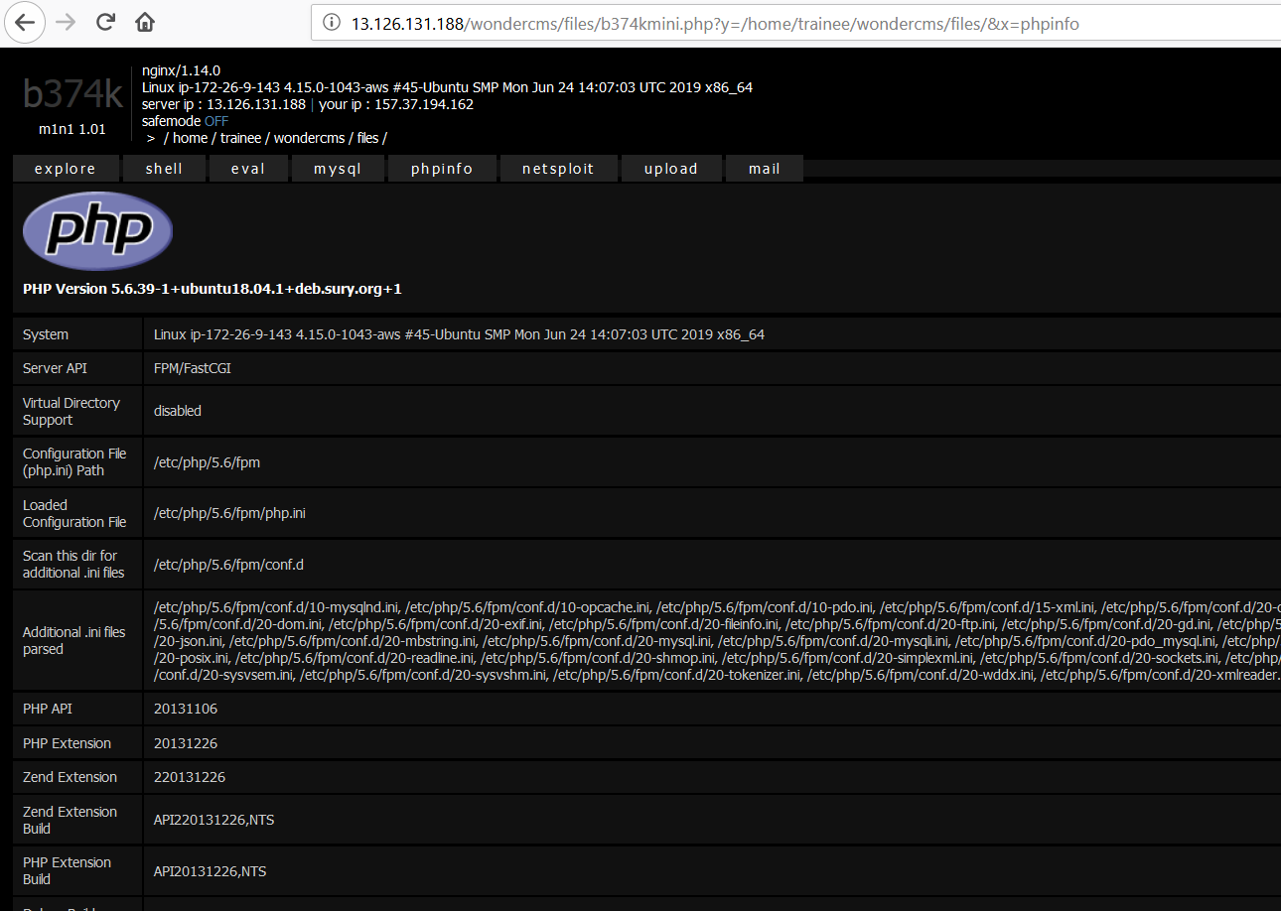
Business Impact – Moderate
Uploading malicious files on server may cause many harmful impact on server.
For Eg;_

Slide 86
Recommendation
Take the following precautions:
File Uploads Checks Must Be implemented Both On Client And Server-Side.
Complete Check Of File Extension.
References:
https://www.owasp.org/index.php/Unrestricted_File_Upload
https://blog.filestack.com/thoughts-and-knowledge/secure-file-upload/

Slide 87
14. Client Side Filter
Client Side Filter (Severe) | Below mentioned urls redirects request to another url Affected URL : http://13.126.131.188/signup/customer.php

Slide 88
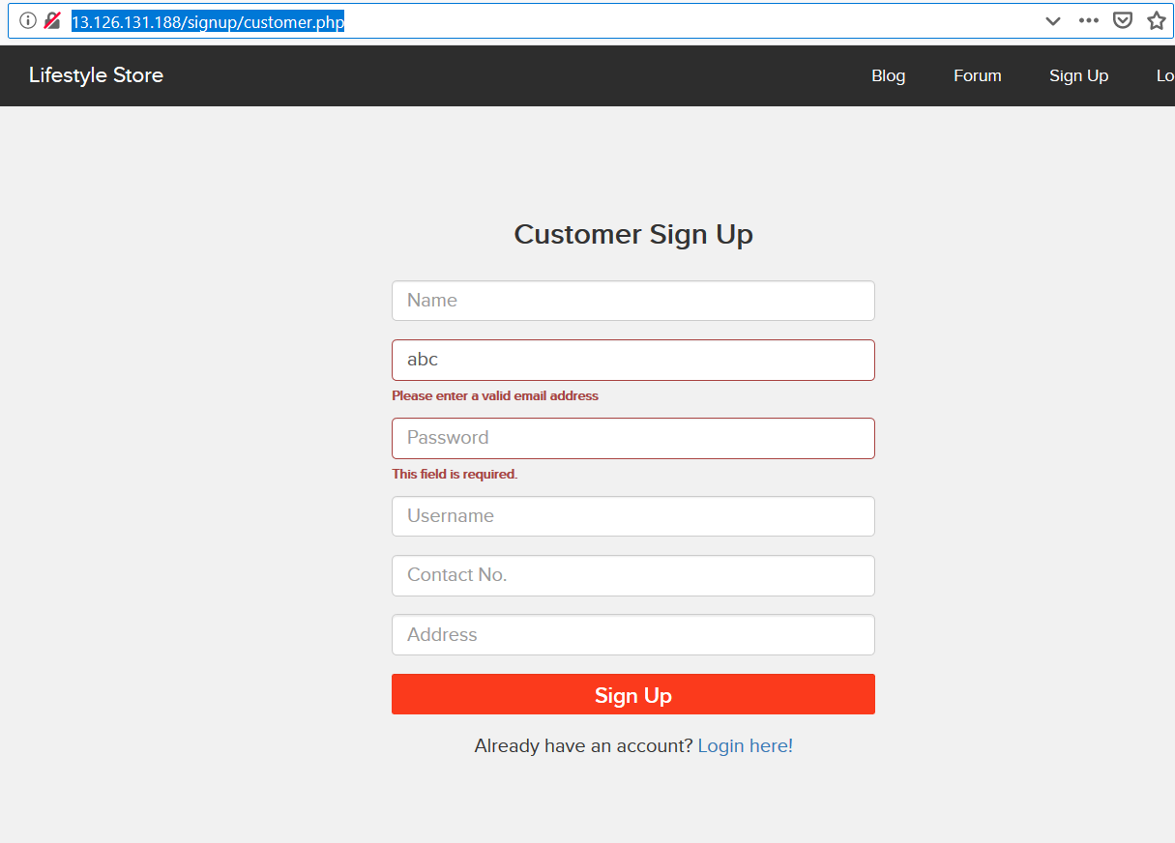
Observation
Navigate to http://13.126.131.188/signup/customer.php And Enter An Invalid Email

Slide 89
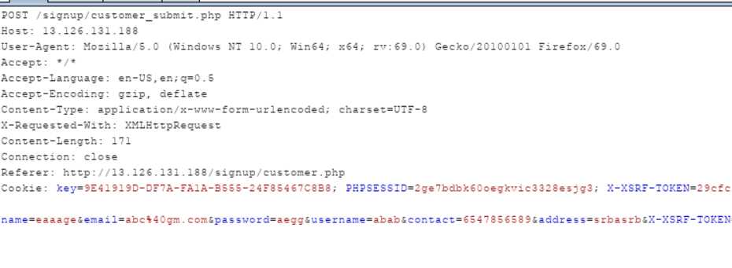
Observation
Enter A Valid Email And Intercept The Request Via proxy tool and change the values as you want:-

Slide 90
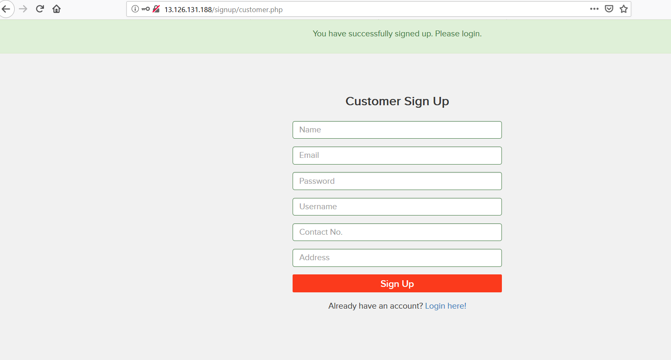
POC

Slide 91
Business Impact – Moderate
Altering Data To Invalid Values May produce Severity In Database And Will Loosen Its Consistency As Well As Security.
Recommendation
Take the following precautions:
Proper Validation Methodology USE.
References:
https://www.paladion.net › blogs › best-practices-in-input-validation
https://www.developsec.com › 2017/06/19 › validation-client-vs-server

Slide 92
15. Server Misconfigurations
Server Misconfiguration (Moderate) | Below mentioned urls have some faults on server side. Affected URL : http://13.126.131.188/phpinfo.php http://13.126.131.188/login/customer.php

Slide 93
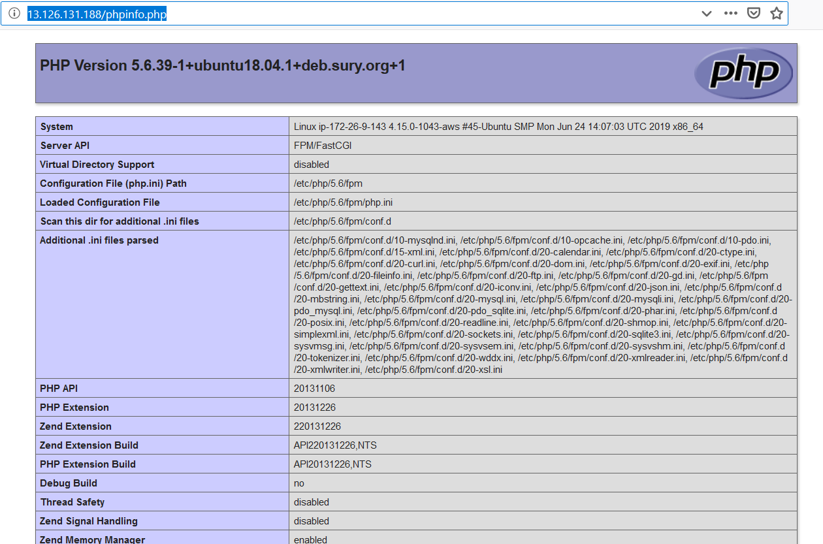
Observation
Navigate to http://13.126.131.188/phpinfo.php

Slide 94
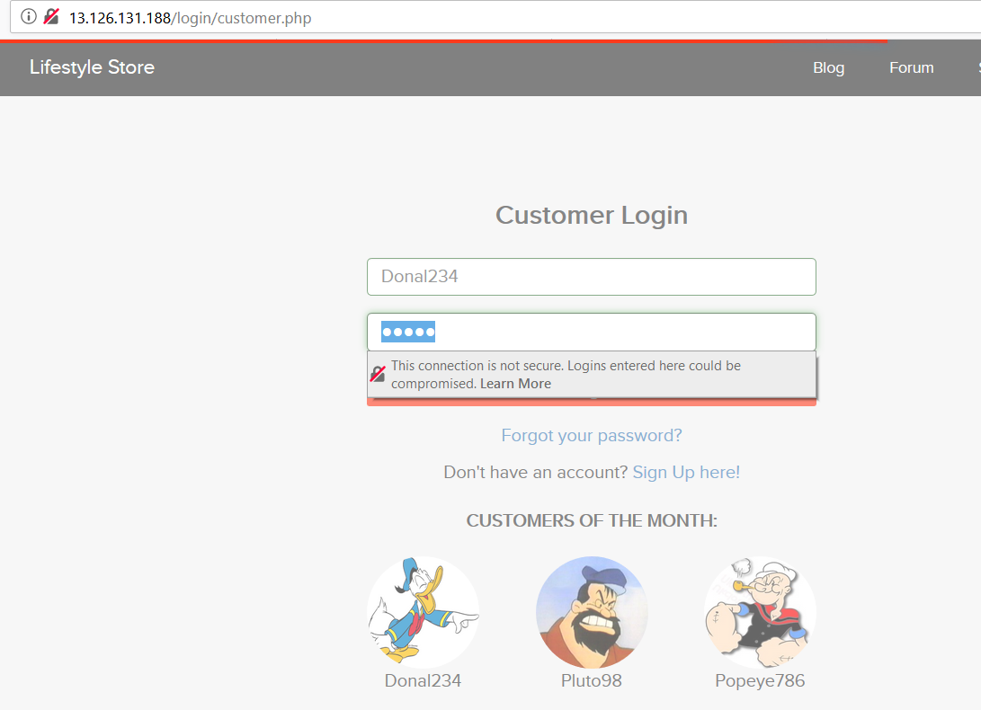
Observation
Input Credentials Are Sent Via HTTP …

Slide 95
Business Impact – Moderate
These Misconfigurations reveals a lot of data about server and moreover sending credentials over http is a very critical task cause they are more prone to be attacked.
Recommendation
Take the following precautions:
Server related Info Should Not Be Revelead.Eg:-PhP version
Input Credentials Should Not Be Sent Over HTTP
References:
https://cwe.mitre.org/data/definitions/601.html
https://dzone.com/articles/what-is-an-open-redirection-vulnerability-and-how

Slide 96
16. Cross Site Request Forgery
Open Redirection (Critical) | Below mentioned urls redirects request to another url Affected URL : http://13.126.131.188/cart/cart.php http://13.126.131.188/signup/customer.php

Slide 97

Observation
Navigate to http://13.126.131.188/cart/cart.php when some items are added to your cart.

Slide 98
Observation
Upload The Following POC File And Send Its Link To Victim.
While testing we get error as:-
CSRF Could Not Be Verfied

Slide 99

POC

Slide 100
Business Impact – Moderate
This Will never Stop And Its Request Will go On and such Multiple Requests May Down The Server.
Recommendation
Take the following precautions:
Redirection URL Should Be accessible and must bounded by time.
References:
https://hdivsecurity.com › owasp-security-misconfiguration
https://bounty.github.com › classifications › security-misconfiguration

Slide 101
17. Components With Known Vunerability
Component With Known Vunerability (Moderate) | Below mentioned Components Have Known Vunerability Title of the Vulnerability: Stored XSS Common Vulnerability Scoring System: 7.0 Vulnerability Class: Injection Technical Details & Description: The application source code is coded in a way which allows user input values to be stored and processed by the application. CVE ID allocated: CVE-2017-14522 Product & Service Introduction: Wonder CMS 2.3.1

Slide 102

Observation
Navigate To /wondercms/ and login to admin panel and under file tab in security setting enter title as <script>alert(“Reflected XSS”)</script>

Slide 103

POC

Slide 104
Business Impact – Moderate
The application code should be configured in such a way, that any random user input be rejected and client and server side validation should be ensured to filter html input and javascript input
The application code should be configured in such a way, that any random user input be rejected and client and server side validation should be ensured to filter html input and javascript input
A attacker can perform session hijacking/ remote port scans as well as deface the site via XSS.
Recommendation
Take the following precautions:
The application code should be configured in such a way, that any random user input be rejected and client and server side validation should be ensured to filter html input and javascript input
References:
https://hdivsecurity.com/owasp-using-components-with-known-vulnerabilities
https://resources.whitesourcesoftware.com/blog-whitesource/owasp-a9-using-components-with-known-vulnerabilities

Slide 105
THANK YOU
For any further clarifications/patch assistance, mail at: gehlotrahulrahul@gmail.com

